Slide 1
Your DL name here

Slide 2
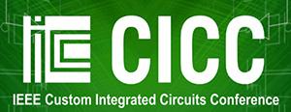
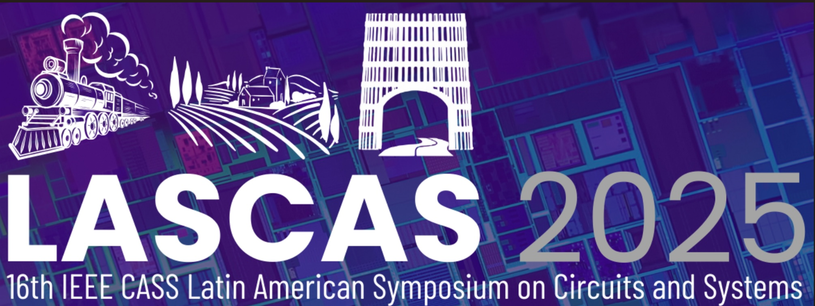
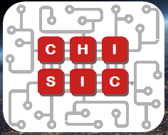
The IEEE Solid-State Circuits Society is Proud to Sponsor
These Prestigious Conferences
Financial Sponsor
Technical Co-Sponsor
February
San Francisco
April
June
Kyoto or Hawaii
September
SSCS Workshop Chiplets Solutions For Custom ICs (CHISIC) will be co-located with CICC!
November
Alessandro Piovaccari: SSCS Meeting Committee
Notes:
ISSCC is the first of five financially sponsored
conferences listed on the left of the slide
We hope to see you at some of these events.
Also, the society is a technical co-sponsor for 12 other
conferences listed on the right slide of the slide.
They include 3 new international collaborations this year-
VLSID in India that was held in January
LASCAF in Uruguay at the end of February
and CAFÉ to be held in Greece in the Fall
AND we are announcing a new SSCS workshop CHISIC
focused on chiplet design is co-located with CICC in Denver.

Slide 3
SSCS Collaborations Across IEEE
SSCS Member Participation is Free!
Dan Friedman: SSCS Councils Communities and Initiative Team
Notes:
In addition to conferences-
SSCS members are actively participating
in 12 technical communities and councils across IEEE
They are shown on this slide.
Participation in any of these SSCS supported
activities is free to members.
If you would like to participate
go online to the IEEE catalog
and add the activity to your membership.
At check-out you will not be charged.

Slide 4
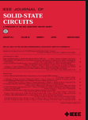
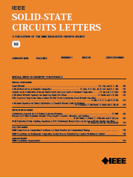
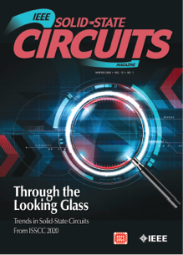
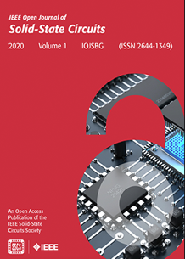
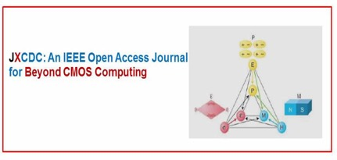
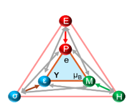
SSCS Publications
JSSC
SSC-L
SSC-Mag
OJ-SSCS
JxCDC
Journal of Solid-State Circuits
Solid-State Circuits Letters
Solid-State Circuits Magazine
Open Journal of the Solid-State Circuits Society
Journal of Exploratory Computational Devices and Circuits
SSCS Members Receive All Publications as a Member Benefit
Shanti Pavan: SSCS Publications Committee
Notes:
The SSCS portfolio of publications is as an
essential resource of technical information and our
membership produces very high quality papers.
In the last year, two of our newest publications:
The Journal of Exploratory Computational Devices
and Circuits
and
Solid State Circuit Letters, have received impact
factor scores.
We have two new publications in development.
RFIC Surveys and Tutorial publication in
collaboration with MTTS and CASS
And
Transaction on Circuits and System
for AI is in development with CASS and CEDA

Slide 5
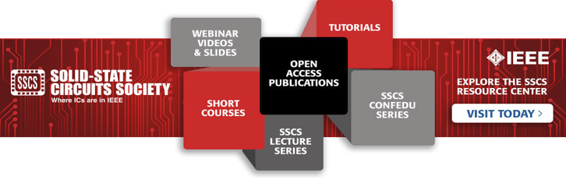
Technical & Career Development
Resources
SSCS Resource Center
SSCS YouTube Channel
resourcecenter.sscs.ieee.org/
www.youtube.com/c/IEEESolidStateCircuitsSociety
Free for SSCS Members
Webinar Videos and Slides
Short Courses and Tutorials: Presentations from the ISSCC
CONFedu: 10-minute talks from conferences
SSCSedu Lectures: Short courses
Free to Everyone
20+ Playlists: Educational content from SSCS Conferences
Circuits Insights
CICCx, VLSIx, …
SSCS Chapter Events
Filip Tavernier : SSCS Education Committee
Notes:
We provide a regular program of webinars, short
courses, and tutorials.
Recordings of these events are available free to
members on the SSCS Resource Center.
It includes an extensive catalog of
Technical, Educational, Career Development Material
[A web link is shown on the left of the slide]
In addition, a selection of educational content,
Conference presentations and chapter meeting
recordings are also available free to all on our you-tube
Channel.

Slide 6
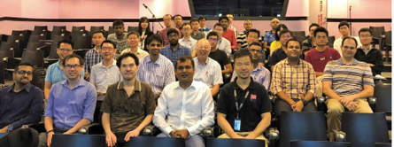
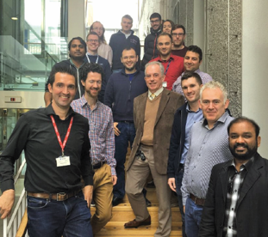
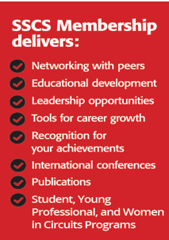
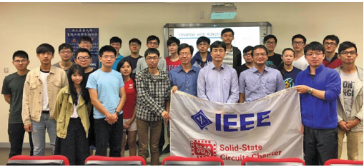
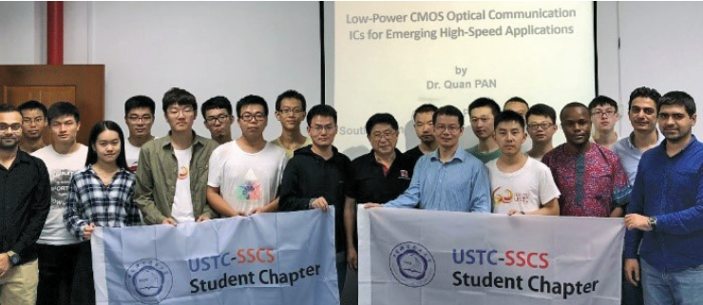
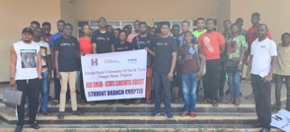
Join, Participate, and Volunteer
>130 Chapters World-Wide:
Technical Talks, Education, Community Service, Social Events
Education Outreach Activities In Progress
PICO Open-Silicon Design Project
Circuit Insights for undergraduates
Student circuit contest
Arduino design contest
OnBoard (PCB design for high school students)
Visit the SSCS display booth in front of the Willow Room to get more information and meet the society team
Become an SSCS Volunteer
https://sscs.ieee.org/volunteer-opportunities
Submit your contact info.
Alvin Loke: SSCS Chapters Committee Mehdi Saligane: Technical Committee on Open-Si
Ali Sheikholeslami: SSCS Education Committee
Notes:
The society has more than 125 chapters worldwide.
They host technical speakers, career development and social events.
We support several educational outreach activities including:
The PICO program, led by Boris Murmann, which provides access to Si
using Open-source tools.
Circuit Insights workshops provide circuit design training to inspire
undergraduate students.
We also run circuit design and Arduino design competitions.
I would like to thank Ali Sheikholeslami and the education
committee for their considerable effort on these activities.
We are also partnering with ‘on-board’ a program to allow high
school students to design with PCBs led by IEEE Fellow John Cohn.
Please stop by the Society Desk outside the Willow Room to meet the society
team and get more information and consider volunteering.
Finally, I would like to thank all our volunteers and staff who’s dedicated work
makes everything happen.
I hope you have a very informative, productive and enjoyable conference.
Thank you.

