Slide 2
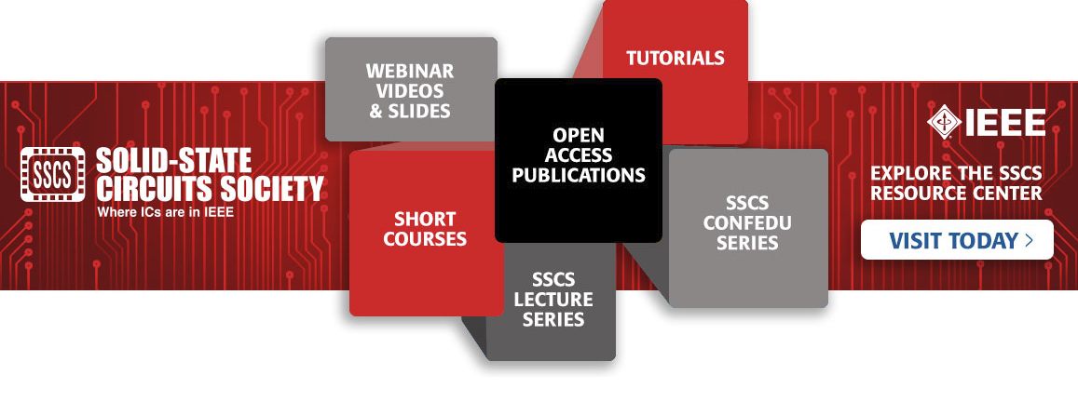
Stay Current with SSCS Education on the Resource Center
The SSCS Resource Center is a platform that includes:
Webinar Videos and Slides: A wide array of topics related to integrated circuits
Short Courses and Tutorials: Presentations from past years of ISSCC
CONFedu Series: 10-minute talks from SSCS-sponsored conferences
SSCSedu Lectures: Short courses that are free to Society Members. Behzad Razavi’s Lecture on Noise now available
www.resourcecenter.sscs.ieee.org
Notes:
Move up to landscape

Slide 3
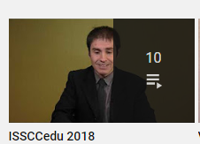
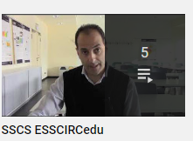
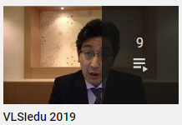
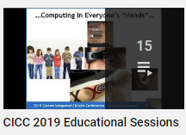
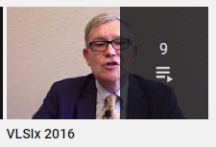
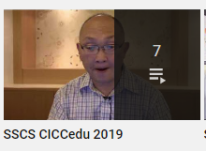
SSCS YouTube Channel
The SSCS YouTube channel has FREE educational content including SSCS’ CONFedu series and Educational Sessions from SSCS sponsored conferences

Slide 4
IEEE Solid-State Circuits Society is Proud to Sponsor These Prestigious Conferences
Join SSCS today to take advantage of discounted rates for these conferences

Slide 5
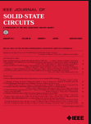
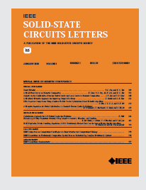
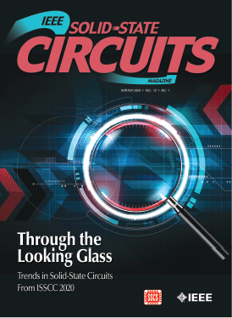
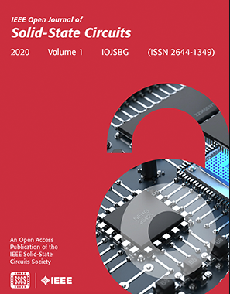
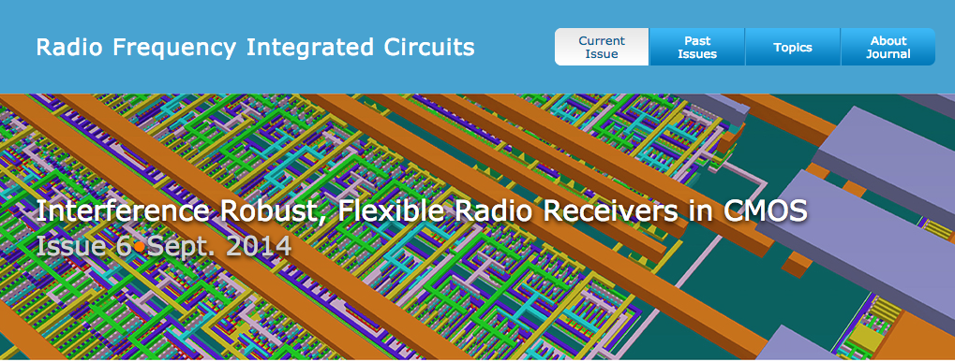
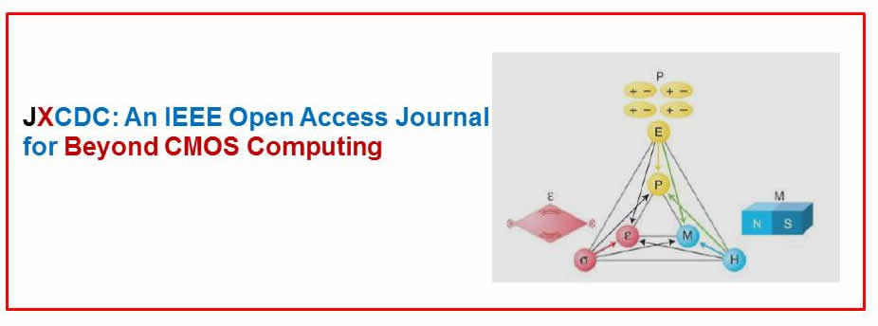
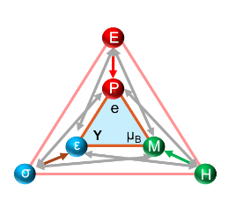
IEEE Solid-State Circuits Society
Flagship Publications
Journal of Solid-State Circuits
Solid-State Circuits Magazine
IEEE Journal of Exploratory
Solid-State Computational Devices and Circuits (JXCDC)
Solid-State Circuits Letters (SSC-L)
RFIC Virtual Journal
NEW – Open Journal of Solid-State Circuits
Join SSCS today to
get these publications as part of your member benefits.

Slide 6
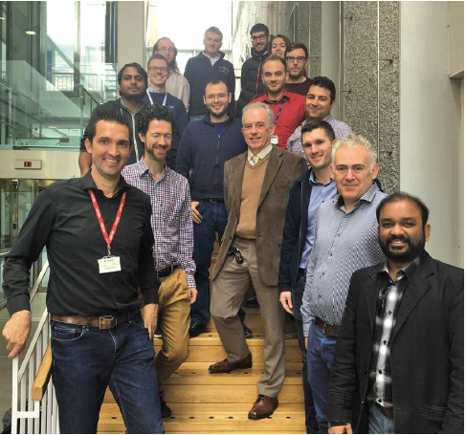
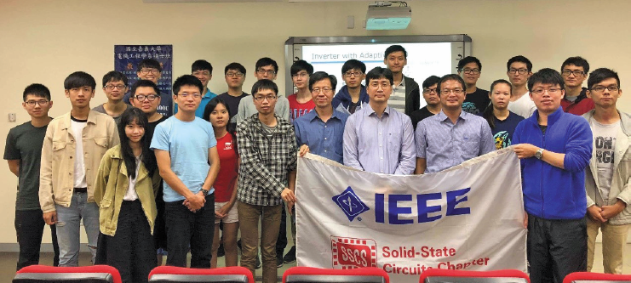
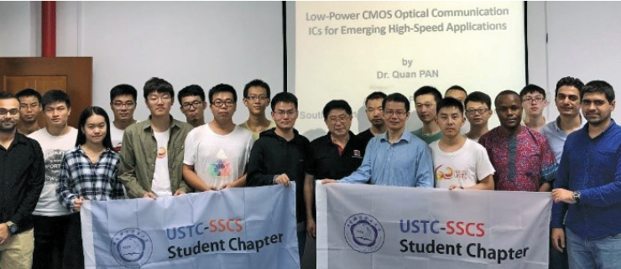
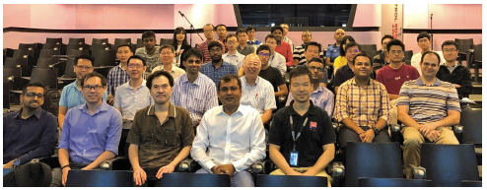
SSCS Chapter-based Conferences and Workshops
Over 110 Chapters Around the World Join and participate in your local Chapter

Slide 7
2022 SSCS Student Circuit Contest Open to Undergraduate and Graduate Students
The goal of this challenge is to design an integrated circuit by using the greatest number of components picked from the provided list.
Awards: Up to three contestants will receive US$2K each towards attending an SSCS-sponsored conference
Deadline for Submissions: June 30th, 2022
More Info: https://sscs.ieee.org/education/2022-sscs-student-circuit-contest

