Slide 2
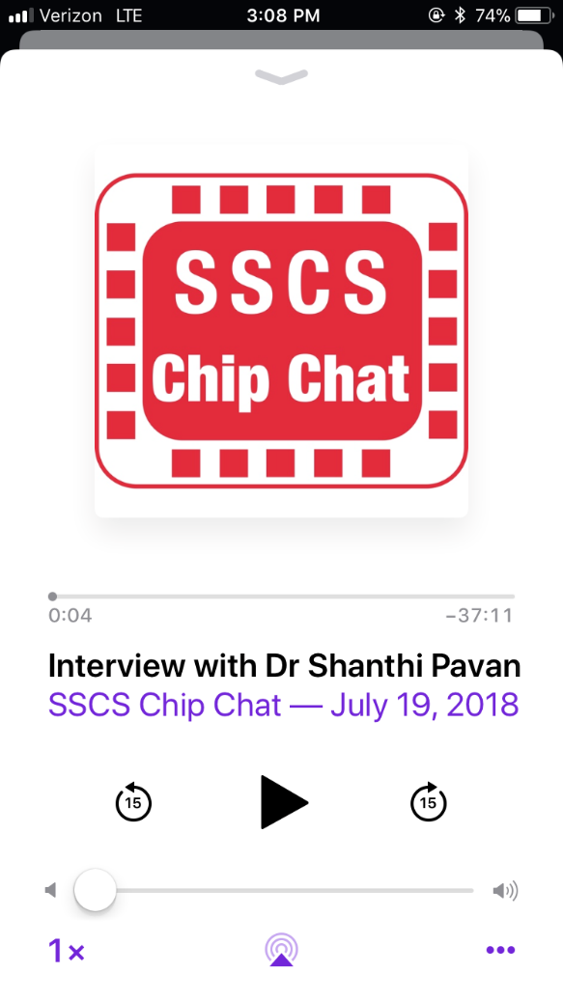
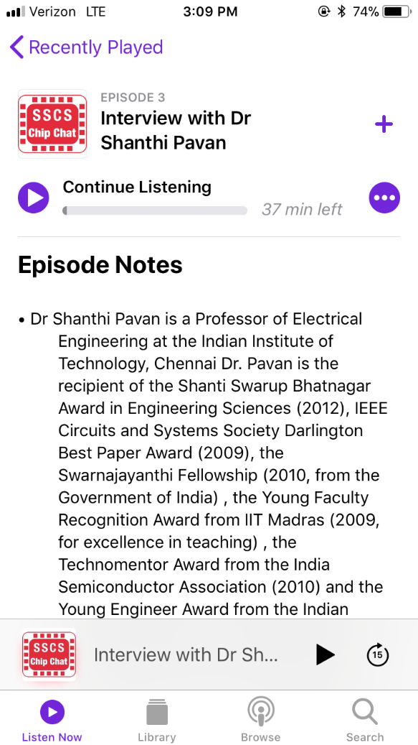
New – SSCS Podcast
Interview style podcast that focuses on the stories of engineers and scientists behind the integrated circuits that power the world
Episodes:
Dr. Gert Cauwenberghs
Dr. Albert Theuwissen
Dr. Shanthi Pavan
Dr. Jake Baker
Shantanu Chakravorty
Dr. Alice Wang (COMING SOON)

Slide 3
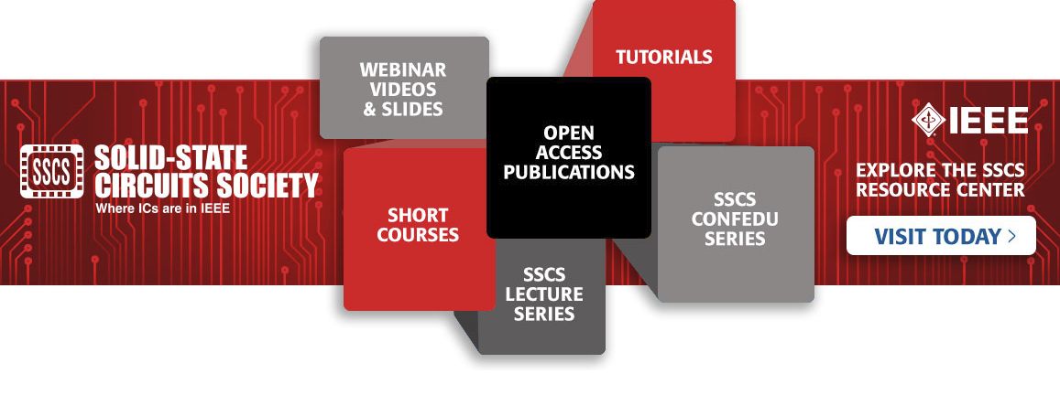
Stay Current with SSCS Education
SSCS Member benefit
The SSCS Resource Center is a platform that includes:
Webinar Videos and Slides: A wide array of topics related to integrated circuits
Short Courses and Tutorials: Presentations from past years of ISSCC
CONFedu Series: 10-minute talks from SSCS-sponsored conferences
SSCSedu Lectures: Short courses that are free to Society Members. Behzad Razavi’s Lecture on Noise now available
www.resourcecenter.sscs.ieee.org
Notes:
Move up to landscape

Slide 4
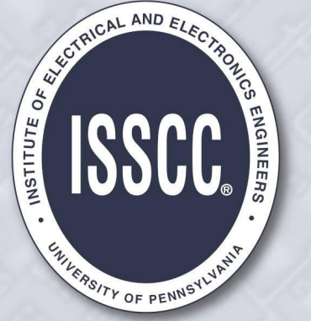
IEEE Solid-State Circuits Society is Proud to Sponsor These Prestigious Conferences
Join SSCS today to take advantage of discounted rates for these conferences

Slide 5
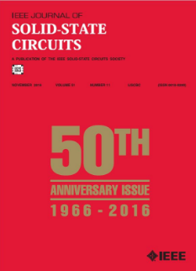
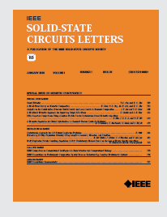
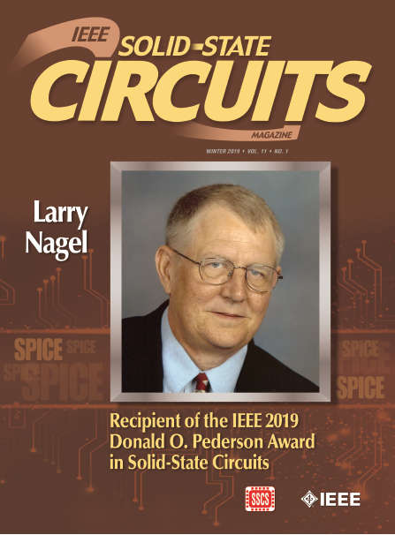
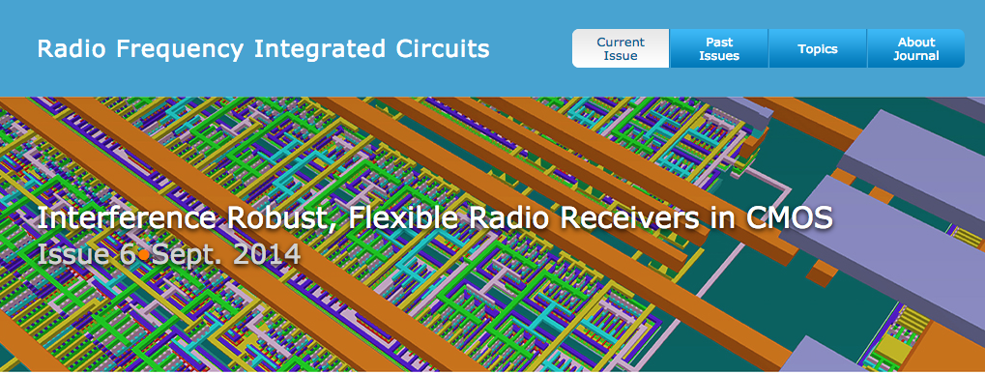
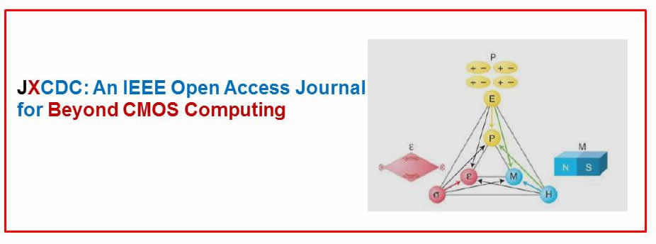
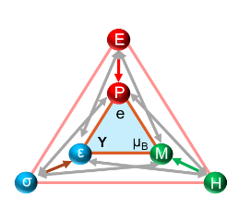
IEEE Solid-State Circuits Society
Flagship Publications
Journal of Solid-State Circuits
Solid-State Circuits Magazine
IEEE Journal of Exploratory
Solid-State Computational Devices and Circuits (JXCDC)
Solid-State Circuits Letters (SSC-L)
RFIC Virtual Journal
Join SSCS today to
get these publications as part of your member benefits.

Slide 6
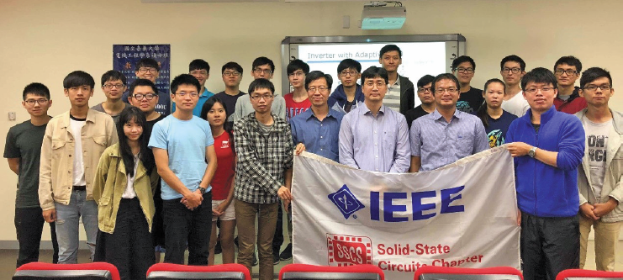
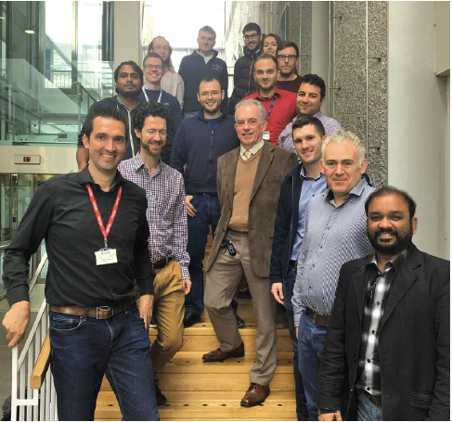
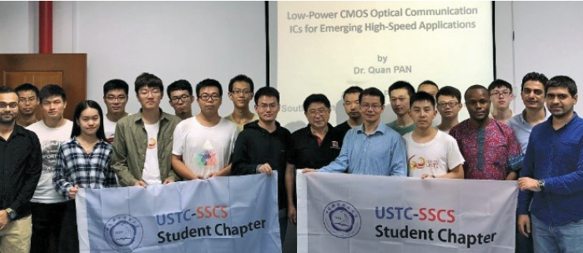
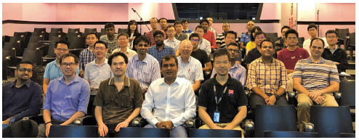
SSCS Chapter-based Conferences and Workshops
Over 110 Chapters Around the World Join and participate in your local Chapter

